Slide 1
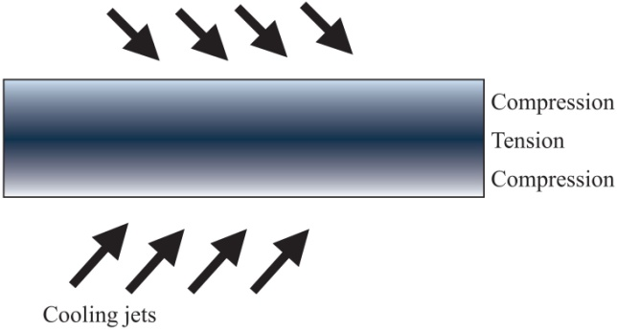
FIGURE 36.1 The Toughening Process for Glass
Copyright © 2016 Elsevier Ltd. All rights reserved.

